Slide 1
Big Data Tools Final Project
Alex Essig

Slide 2
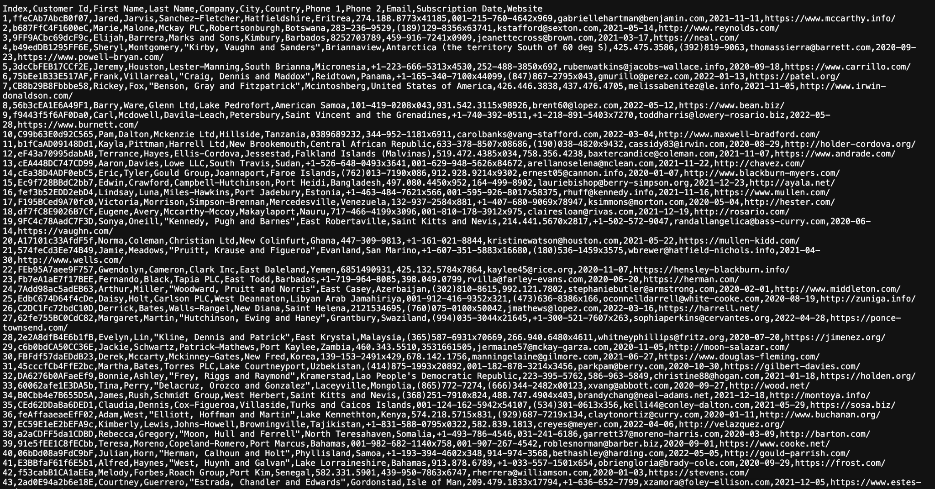
Data

Slide 3
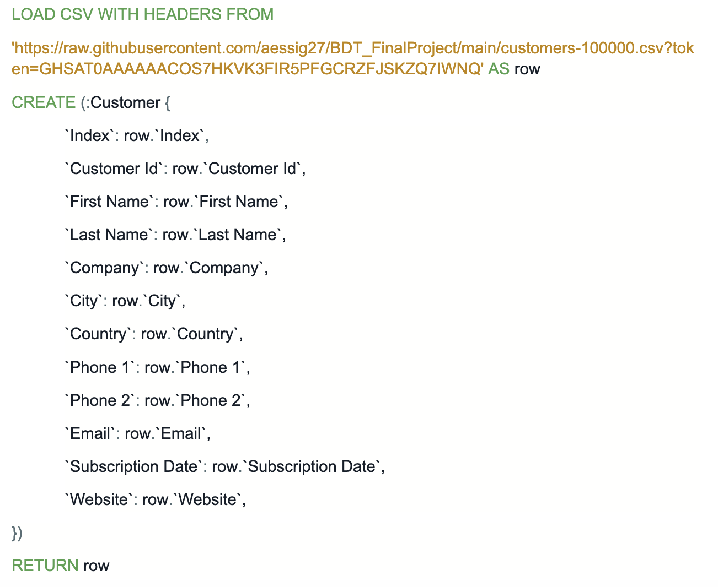
Importing Data to Neo4j

Slide 4
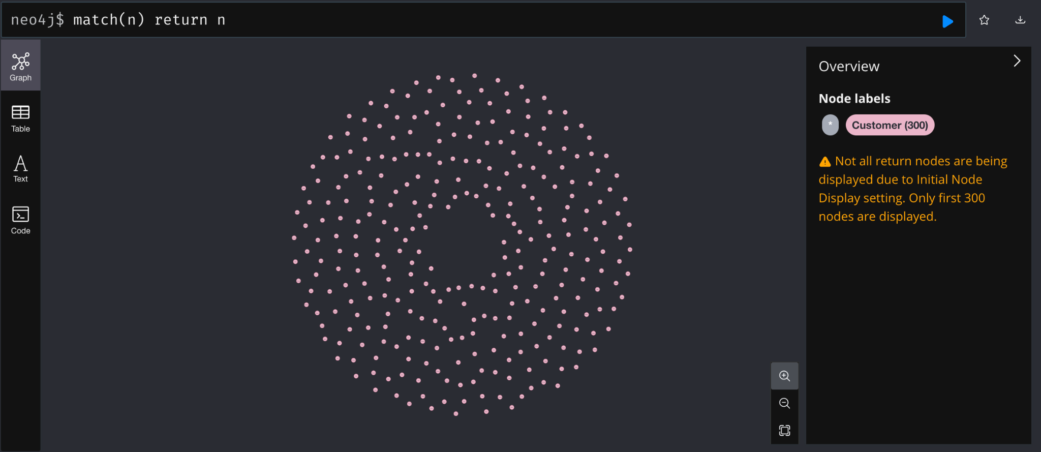
Importing Data to Neo4j

Slide 5
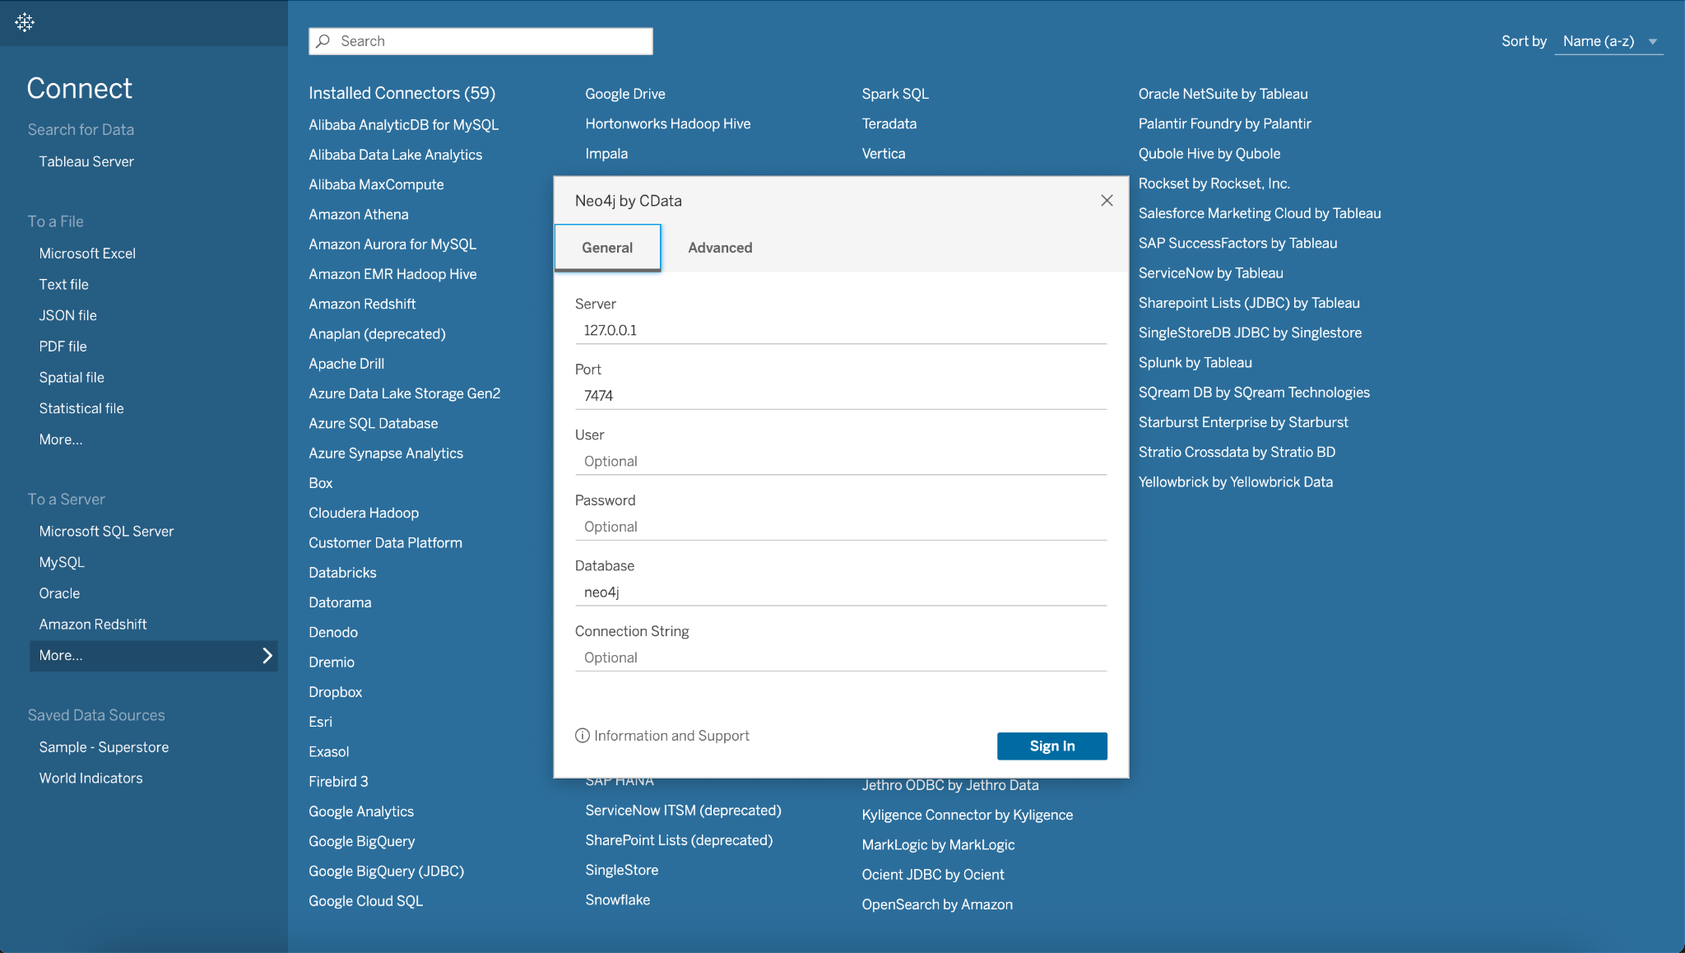
Importing Data from Neo4j to Tableau

Slide 6
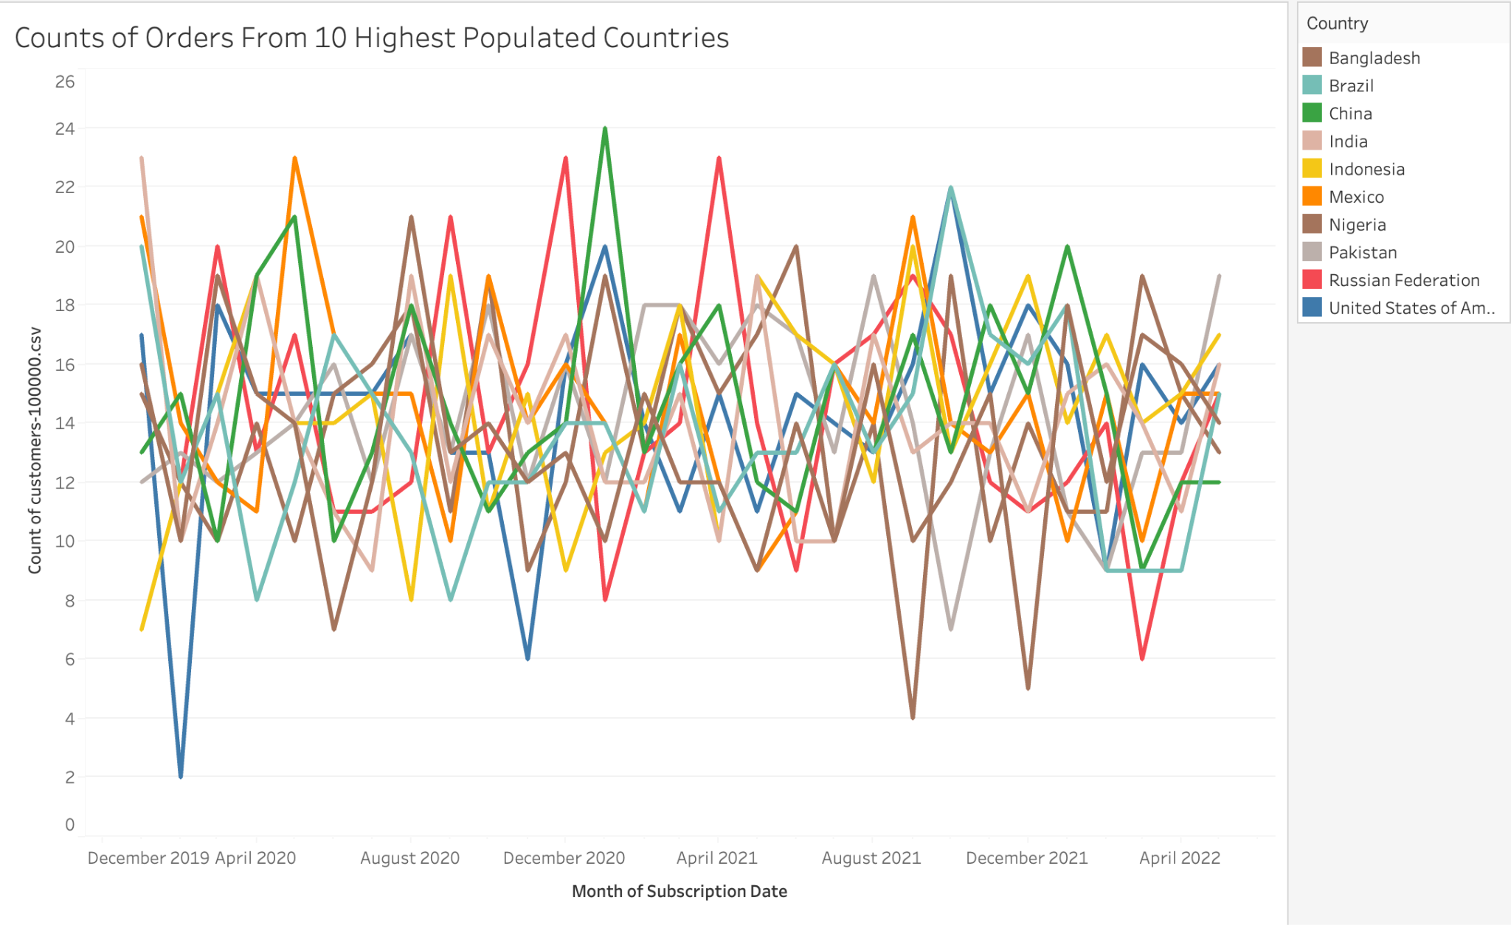

Slide 7
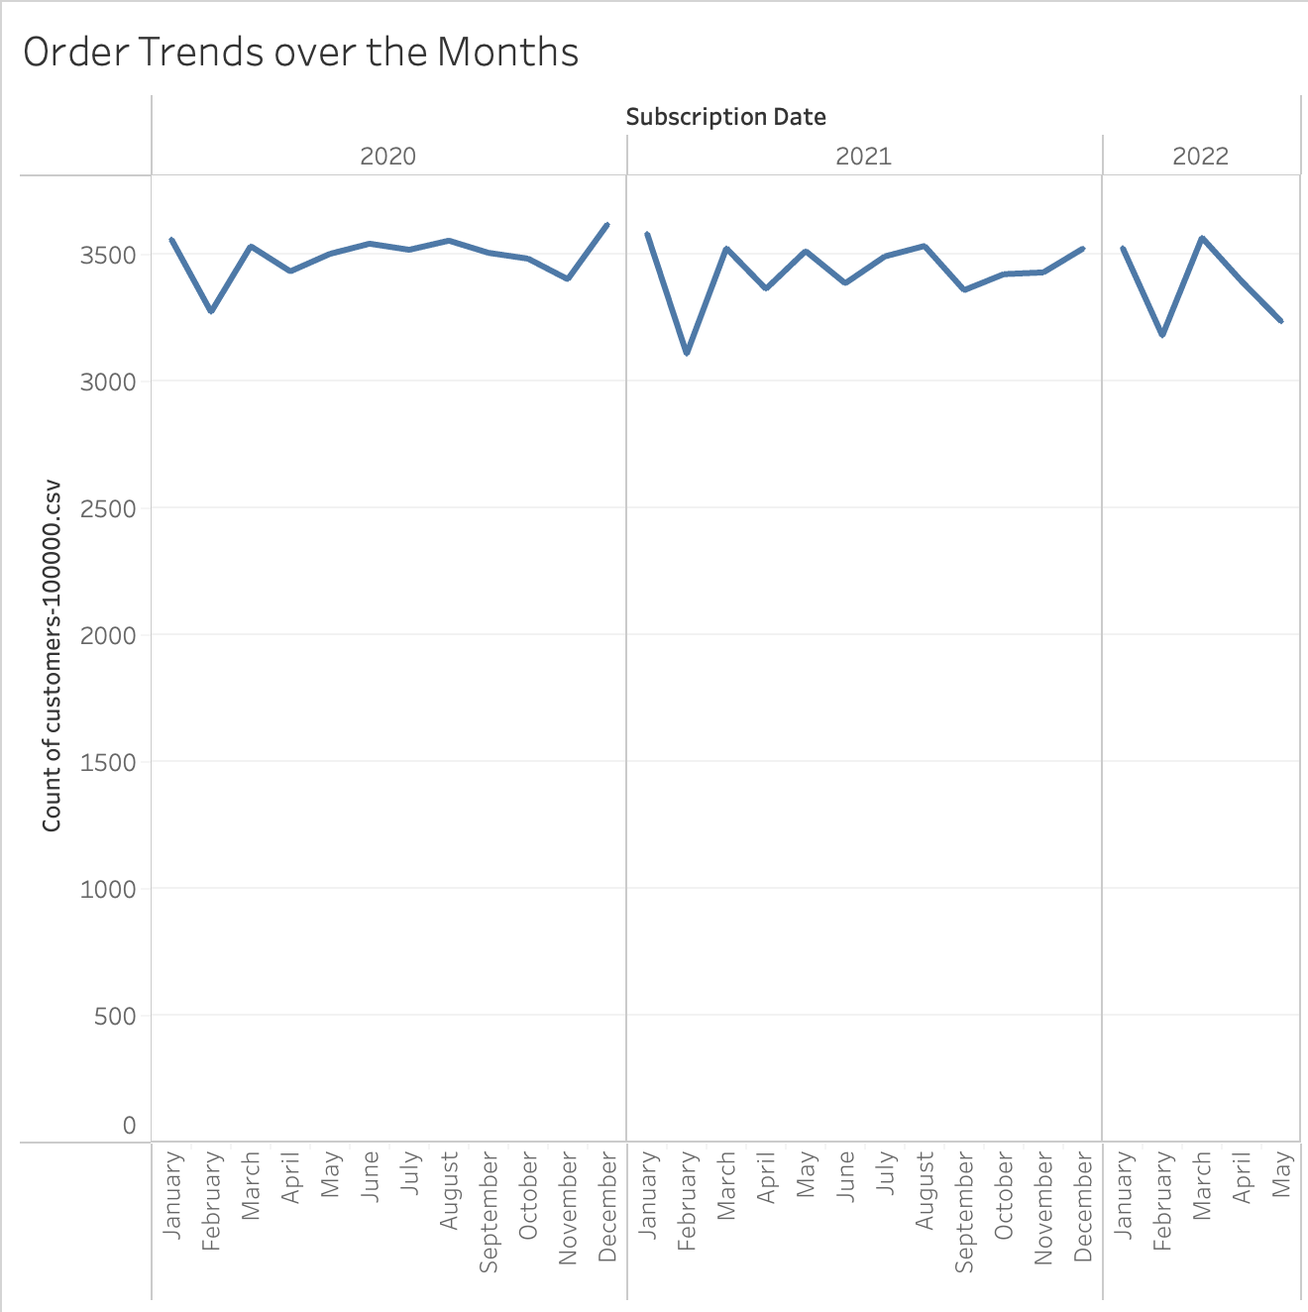

Slide 8
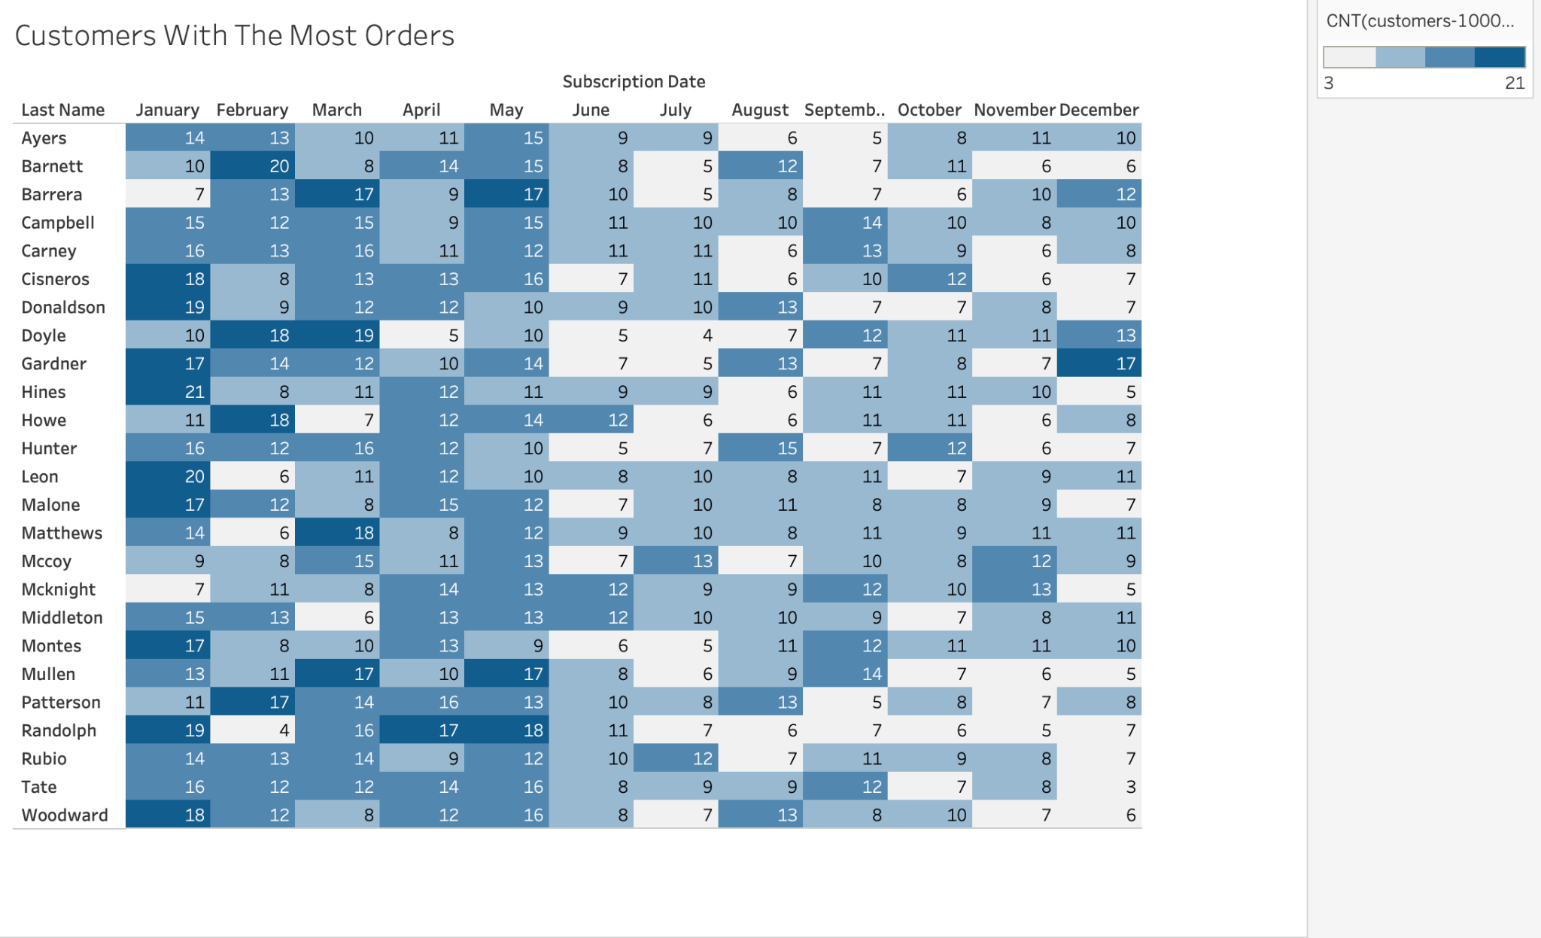

Slide 9
Course Review
What I Liked:
Overall material
Structure of the class
Different tools learned
What I Didn’t Like:
Very fast paced (unavoidable since we only meet once a week)

